Slide 1





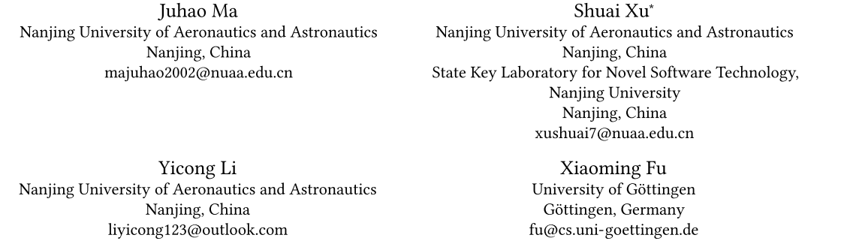





ATAI
Advanced Techniqueof Artificial Intelligence
ATAI
ChongqingUniversity _{AdvancedTechniqueof}
of Technology Artificial Intelligence
Chongqing University of
Technology
Chongqing University ^{ATAI}
_{of Technology} Advanced Techniqueof
Artificial Intelligence
Chongqing University of Technology
Chongqing University of Technology
Multimodal Sentiment Analysis with Multi-Perspective Thinking
via Large Multimodal Models
Code:https://github.com/RMJHQwQ/MPT
—— CIKM_2025
Reported by HongLiang Nie
1

Slide 2

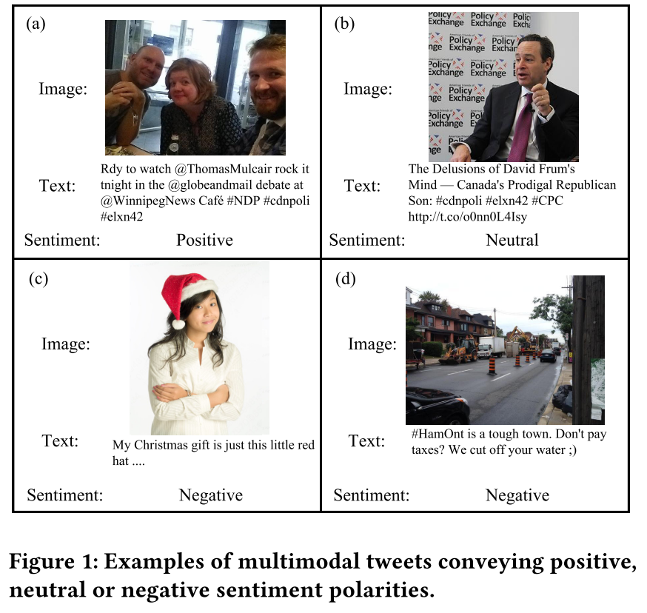
ATAI
AdvancedTechniqueof
Artificial Intelligence
ATAI
ChongqingUniversity _{AdvancedTechniqueof}
of Technology Artificial Intelligence
ChongqingUniversity of Technology
Motivation
1：Traditional approaches are generally limited to extracting surface-level features from different modalities and trying to align them, with little consideration given to the deep semantic connection between the image and the text.
2：The operating mechanism of these traditional approaches is basically like a black box which is unable to provide reasons or reasoning processes for making predictions and therefore lacks interpretability to a large extent.

Slide 3

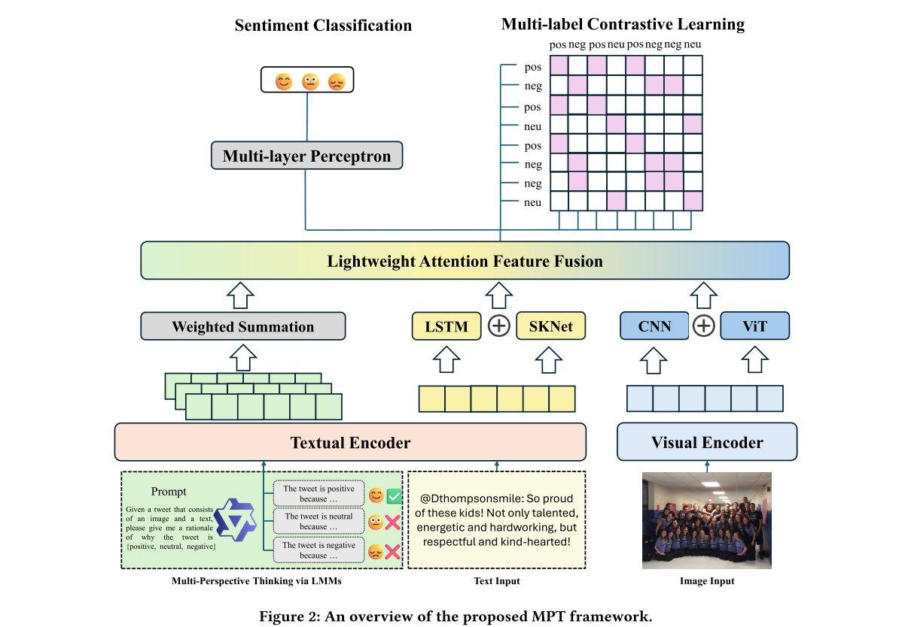
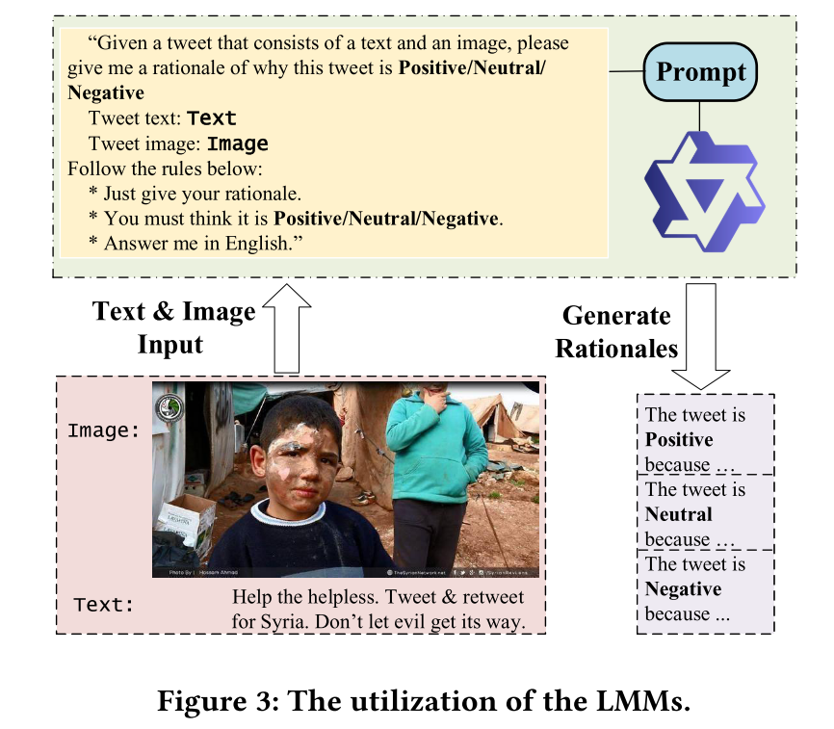
ChongqingUniversity of Technology
ATAI
AdvancedTechniqueof
Artificial Intelligence
ATAI
ChongqingUniversity _{AdvancedTechniqueof}
of Technology Artificial Intelligence
Overview

Slide 4
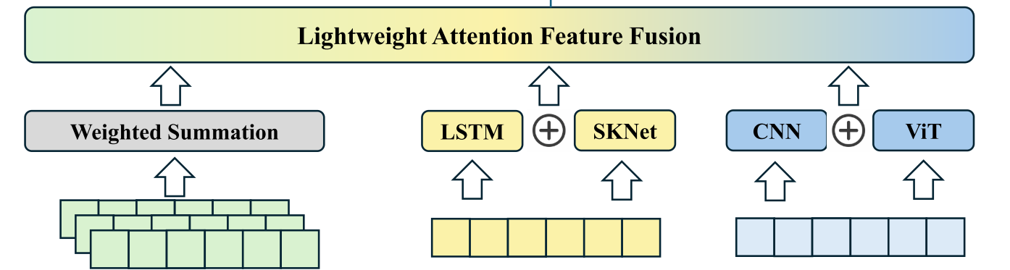

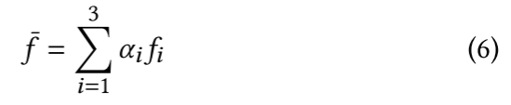
ChongqingUniversity of Technology
ATAI
AdvancedTechniqueof
Artificial Intelligence
ATAI
ChongqingUniversity _{AdvancedTechniqueof}
of Technology Artificial Intelligence
Method

Slide 5
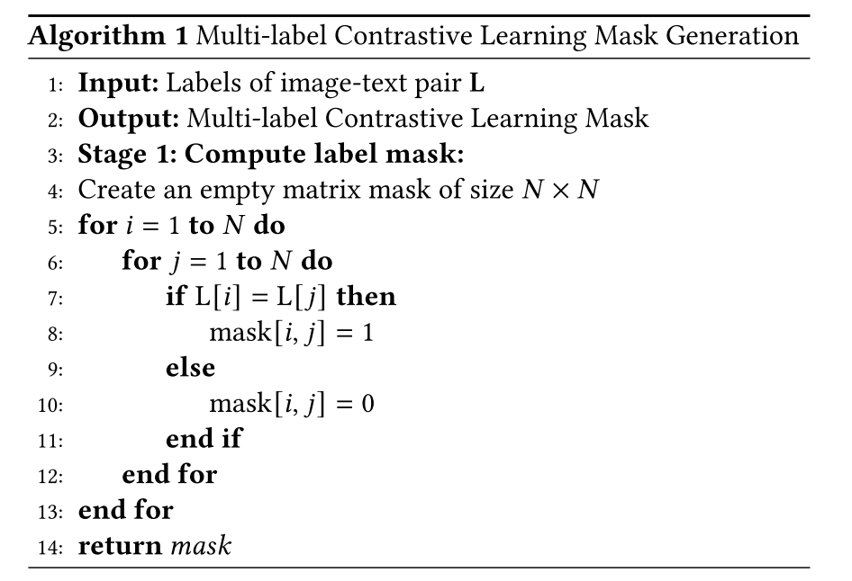
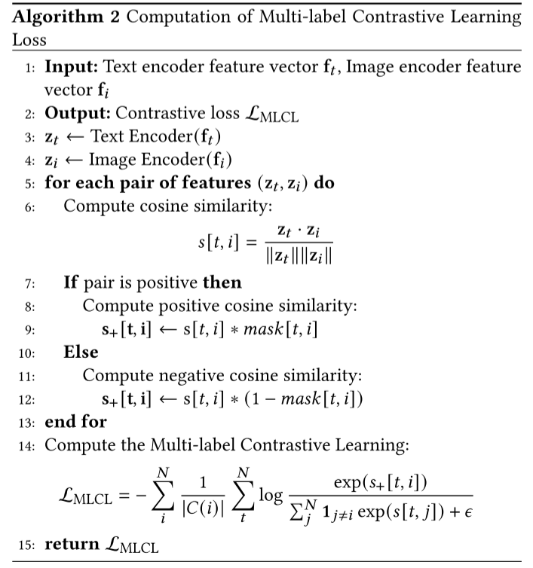
ChongqingUniversity of Technology
ATAI
AdvancedTechniqueof
Artificial Intelligence
ATAI
ChongqingUniversity _{AdvancedTechniqueof}
of Technology Artificial Intelligence
Method

Slide 6

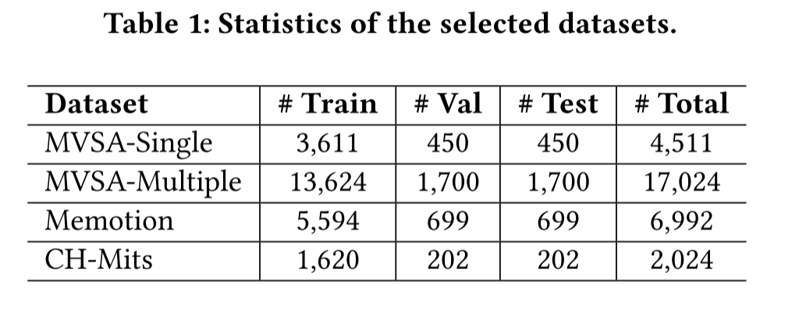
ATAI
AdvancedTechniqueof
Artificial Intelligence
ATAI
ChongqingUniversity _{AdvancedTechniqueof}
of Technology Artificial Intelligence
ChongqingUniversity of Technology
Experiments

Slide 7
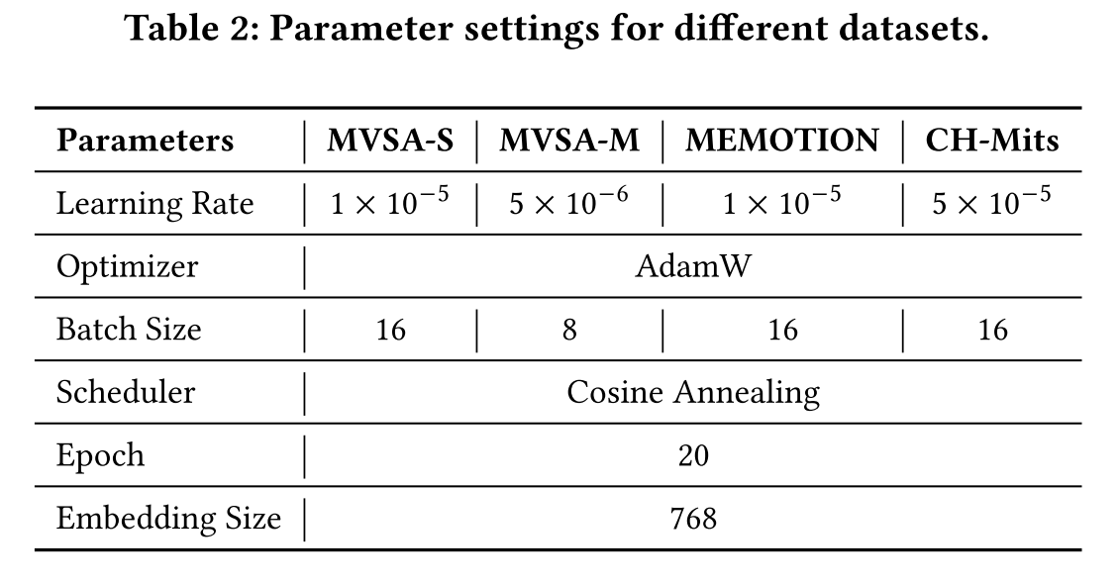
ATAI
AdvancedTechniqueof
Artificial Intelligence
ATAI
ChongqingUniversity _{AdvancedTechniqueof}
of Technology Artificial Intelligence
ChongqingUniversity of Technology
Experiments

Slide 8
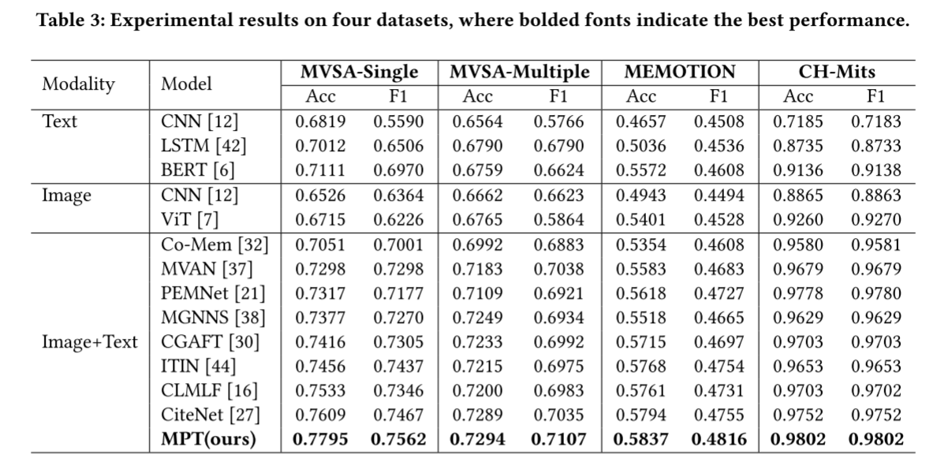
ATAI
AdvancedTechniqueof
Artificial Intelligence
ATAI
ChongqingUniversity _{AdvancedTechniqueof}
of Technology Artificial Intelligence
ChongqingUniversity of Technology
Experiments

Slide 9
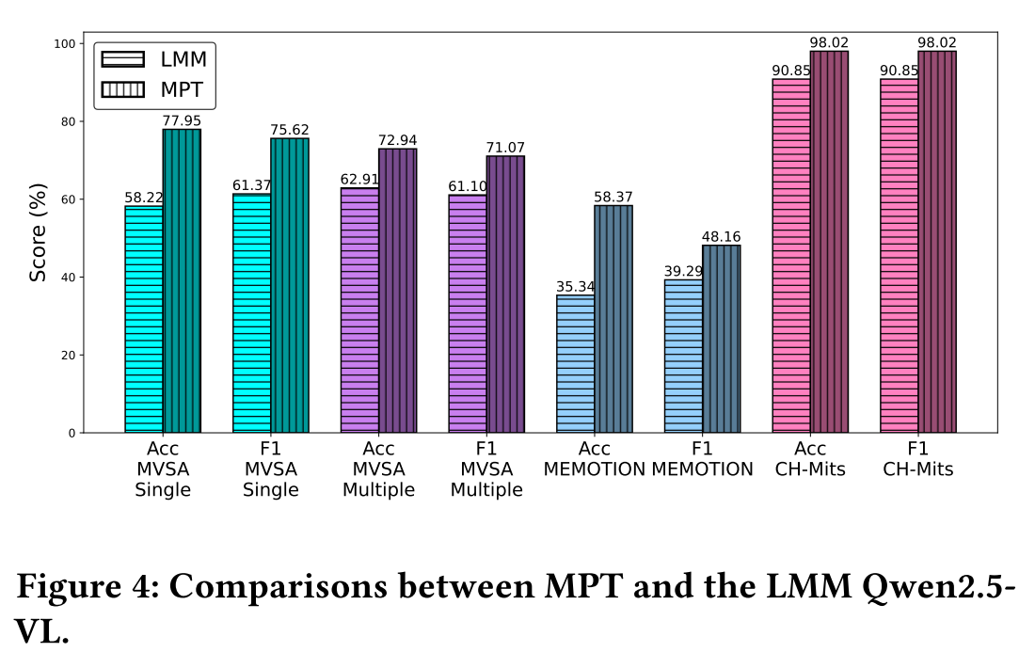
ATAI
AdvancedTechniqueof
Artificial Intelligence
ATAI
ChongqingUniversity _{AdvancedTechniqueof}
of Technology Artificial Intelligence
ChongqingUniversity of Technology
Experiments

Slide 10
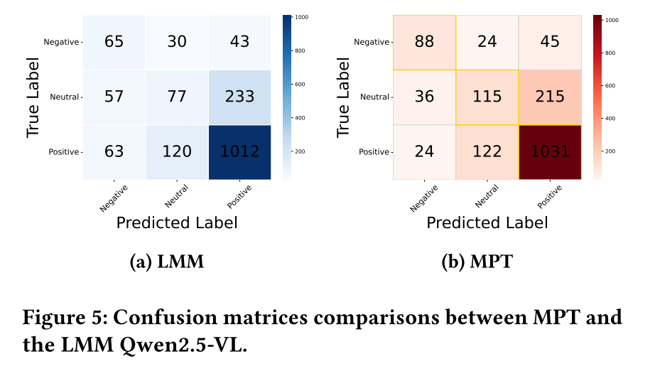
ATAI
AdvancedTechniqueof
Artificial Intelligence
ATAI
ChongqingUniversity _{AdvancedTechniqueof}
of Technology Artificial Intelligence
ChongqingUniversity of Technology
Experiments

Slide 11
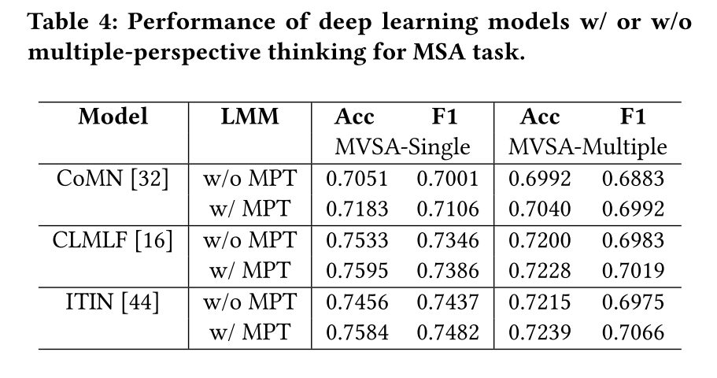
ATAI
AdvancedTechniqueof
Artificial Intelligence
ATAI
ChongqingUniversity _{AdvancedTechniqueof}
of Technology Artificial Intelligence
ChongqingUniversity of Technology
Experiments

Slide 12
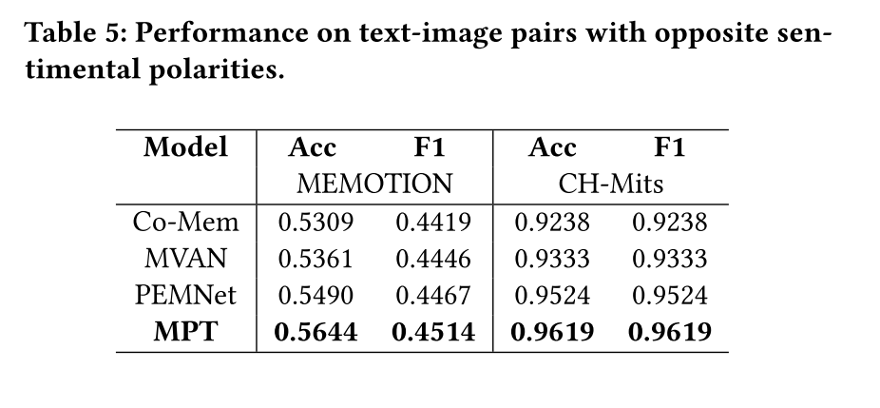
ATAI
AdvancedTechniqueof
Artificial Intelligence
ATAI
ChongqingUniversity _{AdvancedTechniqueof}
of Technology Artificial Intelligence
ChongqingUniversity of Technology
Experiments

Slide 13
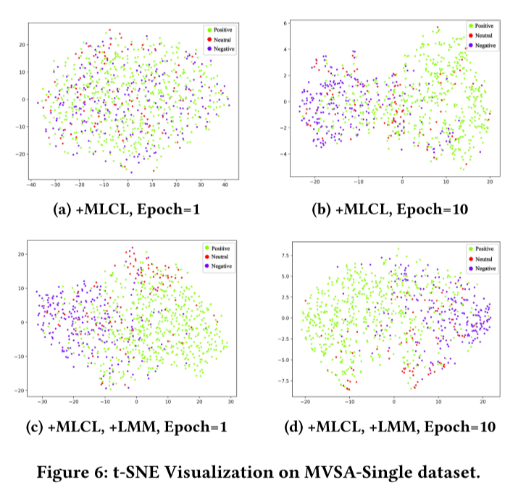
ATAI
AdvancedTechniqueof
Artificial Intelligence
ATAI
ChongqingUniversity _{AdvancedTechniqueof}
of Technology Artificial Intelligence
ChongqingUniversity of Technology
Experiments

Slide 14
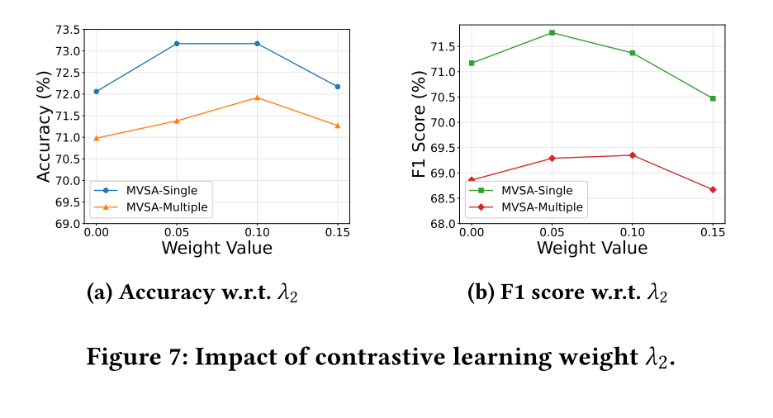
ATAI
AdvancedTechniqueof
Artificial Intelligence
ATAI
ChongqingUniversity _{AdvancedTechniqueof}
of Technology Artificial Intelligence
ChongqingUniversity of Technology
Experiments

Slide 15
ATAI
AdvancedTechniqueof
Artificial Intelligence
ATAI
ChongqingUniversity _{AdvancedTechniqueof}
of Technology Artificial Intelligence
ChongqingUniversity of Technology
Experiments

Slide 16
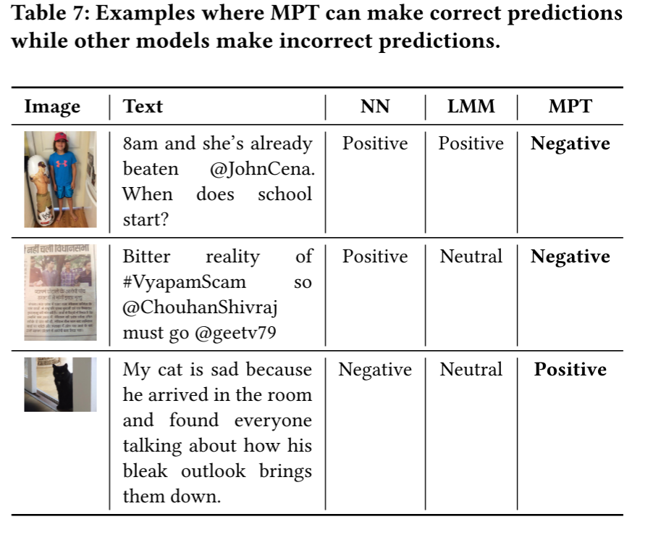
ATAI
AdvancedTechniqueof
Artificial Intelligence
ATAI
ChongqingUniversity _{AdvancedTechniqueof}
of Technology Artificial Intelligence
ChongqingUniversity of Technology
Experiments

Slide 17
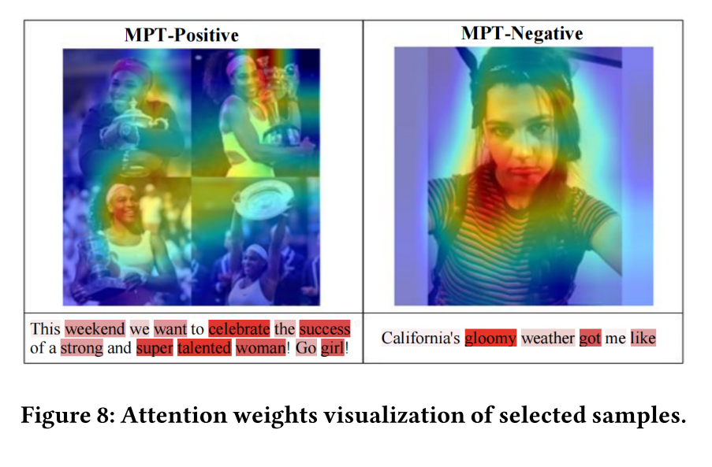
ATAI
AdvancedTechniqueof
Artificial Intelligence
ATAI
ChongqingUniversity _{AdvancedTechniqueof}
of Technology Artificial Intelligence
ChongqingUniversity of Technology
Experiments

Slide 18


ChongqingUniversity of Technology
ATAI
AdvancedTechniqueof
Artificial Intelligence
ATAI
ChongqingUniversity _{AdvancedTechniqueof}
of Technology Artificial Intelligence
Thanks!

